Slide 1
Year 10 Homework booklet Order and Disorder
NAME:
ART GROUP:
DATE SET Summer Term | DESCRIPTION | STUDENT CHECK | TEACHER CHECK
4/05/15 | 1) Audrey Flack Response Arrange 4-5 personal possessions in an ordered or disordered way (photograph them) and create a 30 minute drawing from them. (see examples on page 2)
11/05/15 | 2) Mixed Media study Produce a mixed media observational study of the possessions you arranged. (see examples on page 3)
18/05/15 | 3) Pen drawing Produce a 30 minute pen drawing from one of your photos or images in your sketchbook. (see examples on page 4)
25/05/15 | 4) Own photographs Take 10-15 of your own photos which link to Order & Disorder examples: Portraits, Objects (see examples on page 5)
1/06/15 | 5) Observational drawings Produce 2-3 drawings from your photographs/ images (see examples on page 6)
8/06/15 | 6) Observational drawings Produce 2-3 drawings from your photographs/ images (see examples on page 6)
15/06/15 | 7 ) Design Ideas Complete design ideas for exam (see examples on page 7)
22/06/15 | 8) Final Idea Draw out your final exam idea and add materials to this (see example on page 7)
29/06/15 | 9) Evaluation Complete exam evaluation sheet (see page 8)
6/07/15 | 10) Complete ALL unfinished work
13/07/15 | 11) Complete ALL unfinished work

Slide 2
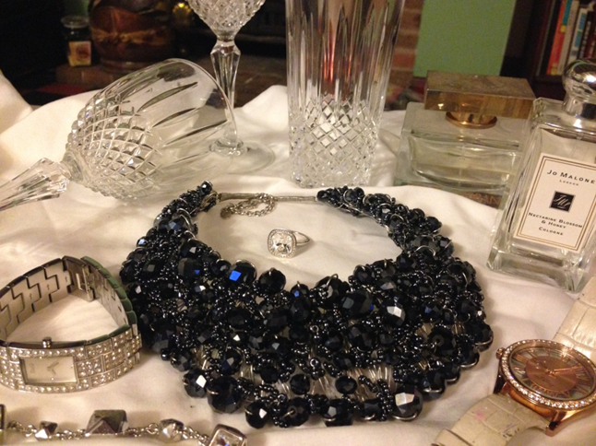
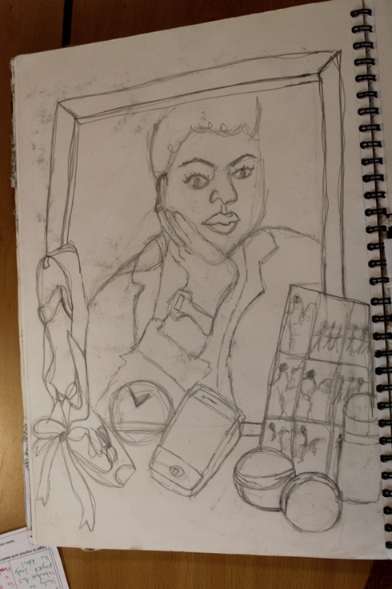
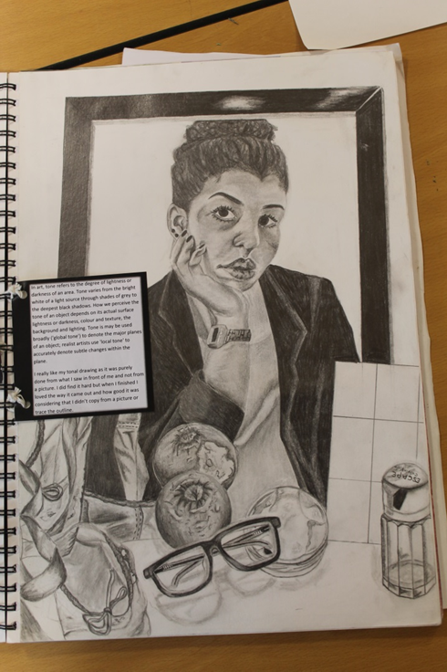
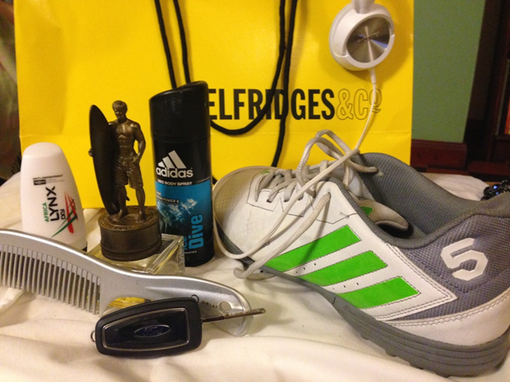
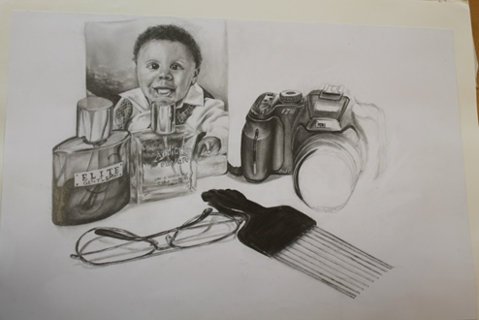
Own Photos
Objects/Portraiture
30 Minute drawing

Slide 4
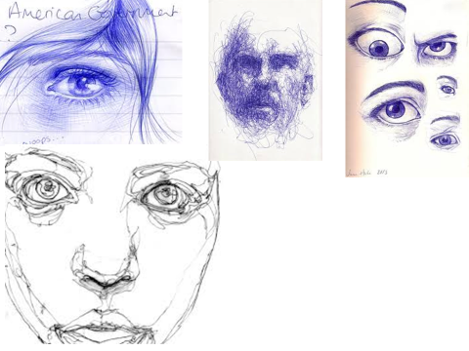
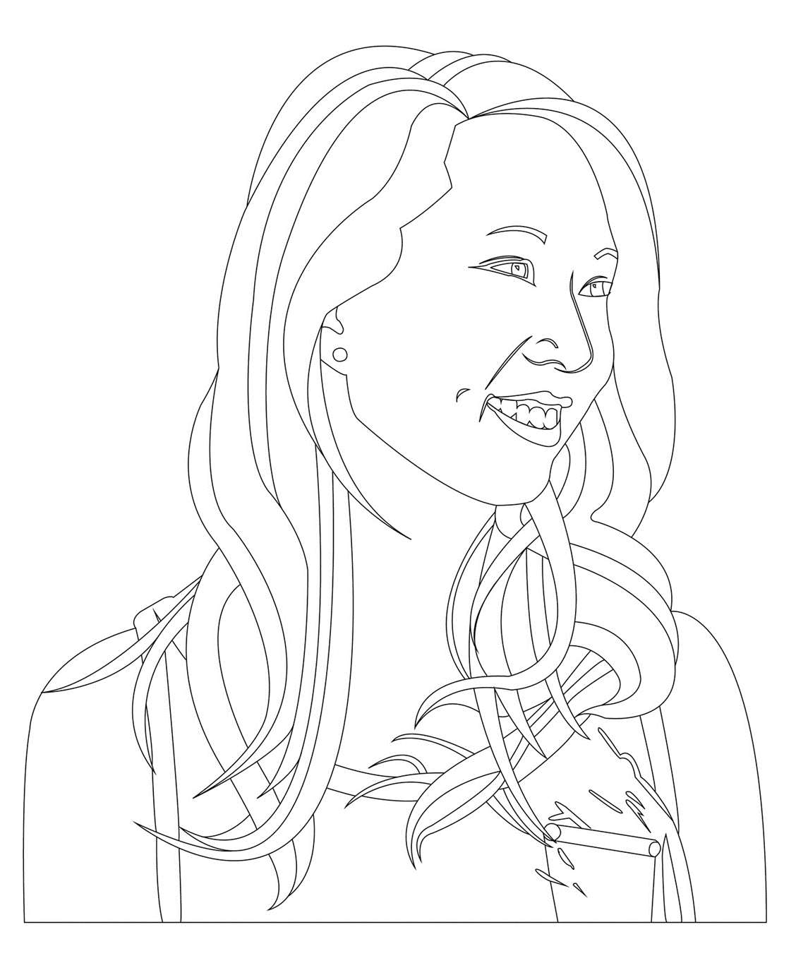

Slide 5
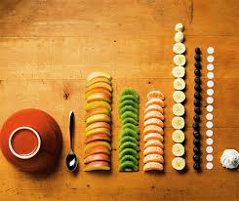
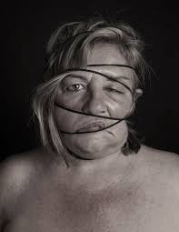
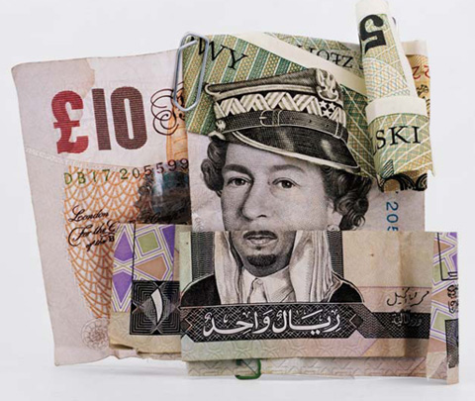
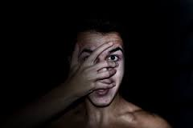
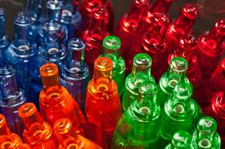
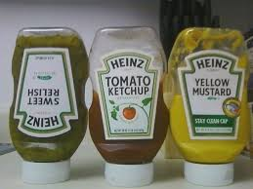
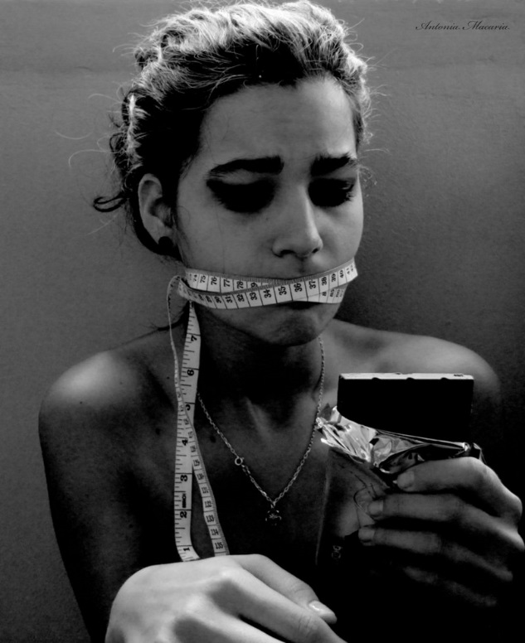
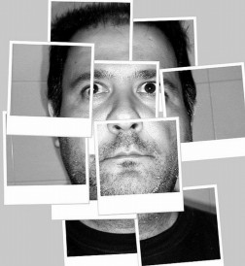
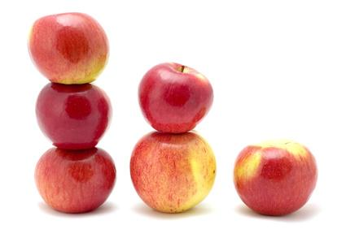
Order and Disorder own Photographs

Slide 6
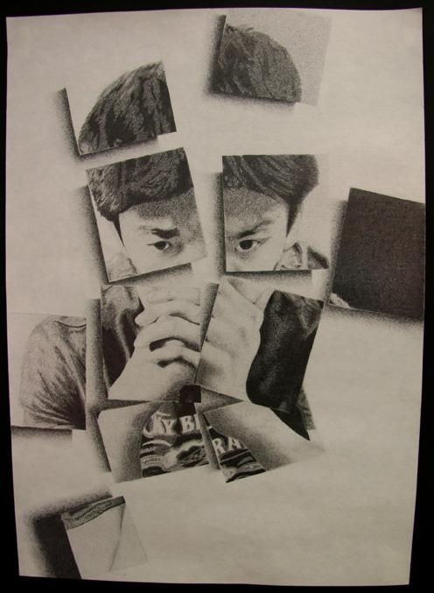
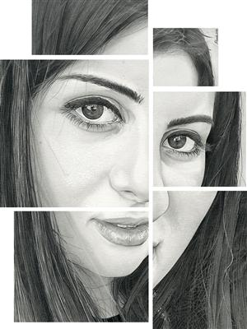
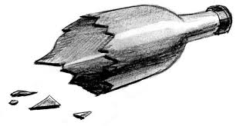
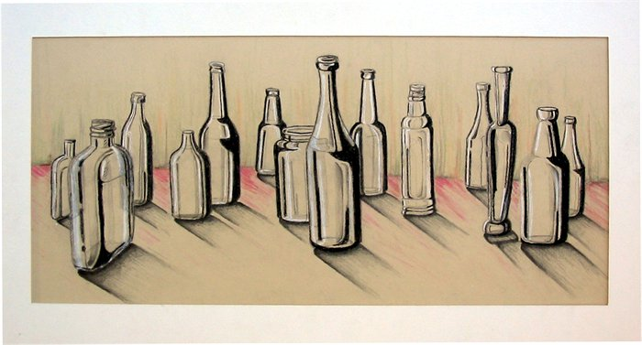

Slide 7
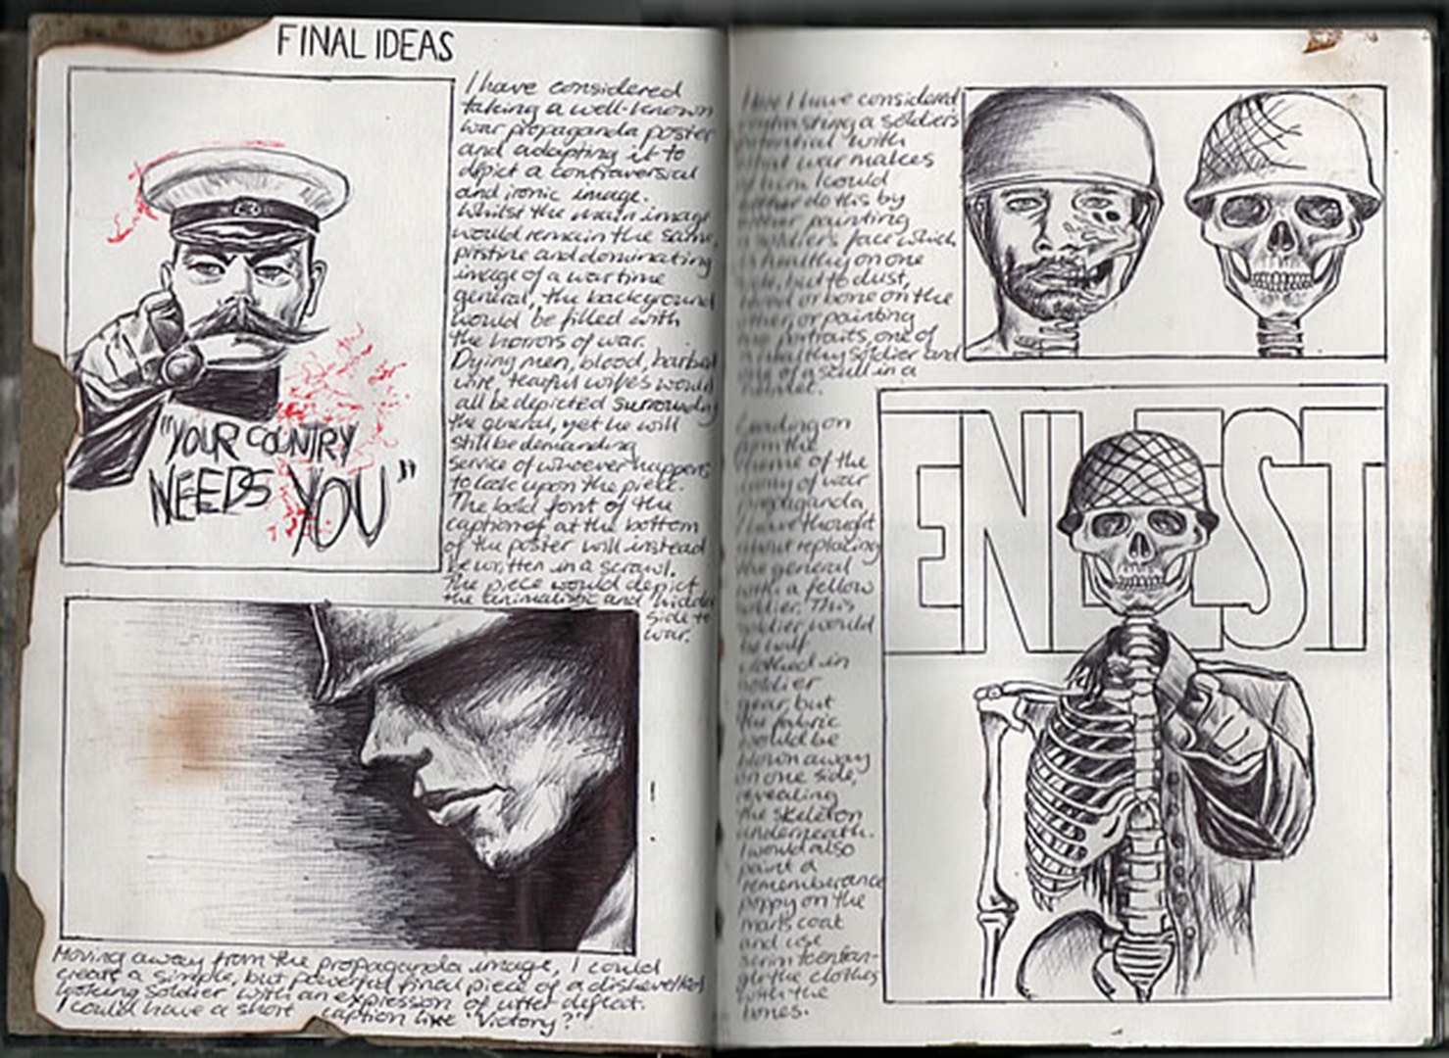
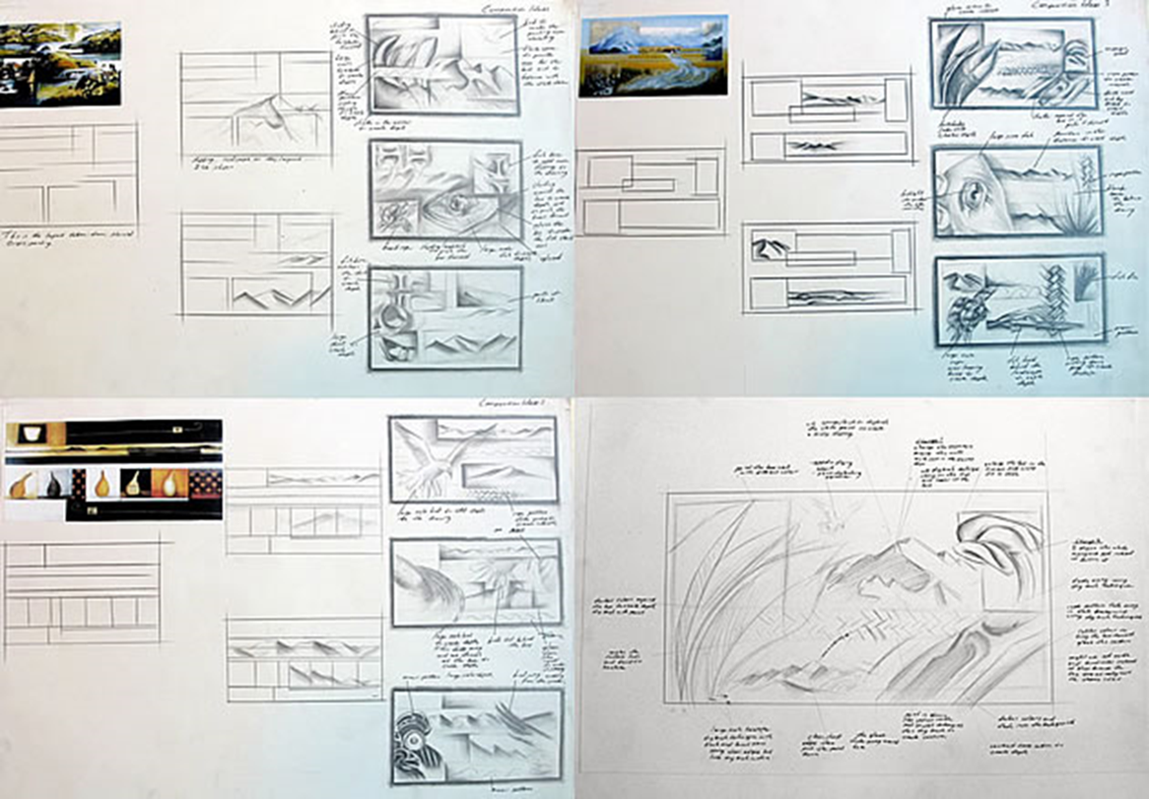
DESIGN IDEAS

Slide 8
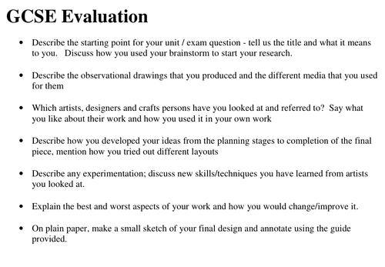
EXAM
EVALUATION

